Slide 1
The care partner experience and the young adult with advanced cancer
Samantha Fischbach, PhD, rn, chpn
Assistant professor, south Dakota state university

Slide 2
objectives
Describe the caregiving experiences of young adult partners of individuals with advanced cancer
Identify unmet needs and challenges specific to this age group
Discuss actionable strategies for healthcare professionals and care team members to strengthen caregiver support in oncology and palliative care settings.

Slide 3

Purpose & Significance
Cancer = one of the leading causes of death in young adults
Higher rate of delayed diagnosis
Delay in treatment
Care partners report lower quality of life
Literature lacked exploration of young adult care partners
(Adobe Stock, 2024)
(AARP Family Caregiving, 2020; Administration for Community Living, 2017; American Cancer Society, 2024; DiGiulio, 2023; Dommett et al., 2019)

Slide 4
methods
Qualitative
Lived experiences
Defined ‘young adult’ and ‘care partner’
Purposive Sampling
7 participants
Gender | Male | 0
 | Female | 7
Relationship Status | Unmarried | 0
 | Married | 7
Past or Present Care Partner (at the time of the interview) | Past | 3
 | Present | 4
Interview Method | Phone call | 3
 | In-person | 1
 | Zoom | 3
(Abalos et al., 2016; Carbery et al., 2021; Fischbach, 2024; Holloway & Galvin, 2017; Istanboulian et al., 2024)

Slide 5
“describe to me what it is like to help care for your significant other”

Slide 6
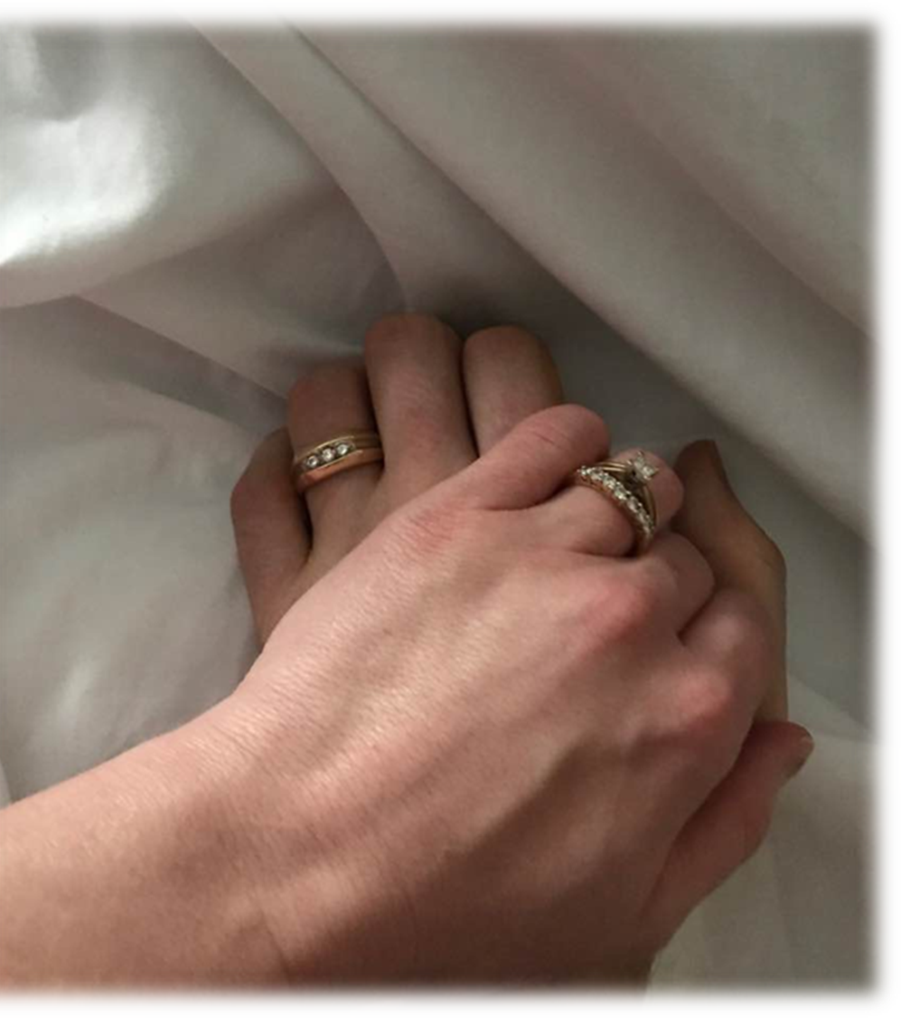
results
Category 1: Emotional Impact of Grief
Anticipatory grief
Helplessness and anger
Relief and guilt dynamics
“[My mind] went to,
I’m glad it’s not the kids.”

Slide 7
results
Category 2: Role Disproportion and Adaptation
Transfer of responsibilities
Care partner becomes medical coordinator
“…you’re starting to help them do it, and then the next thing you know, you're doing everything alone.”

Slide 8
results
Category 3: Coping Strategies and Faith
Relying on God
Finding joy
“It sucks, but we’ve been through all the crying and the emotions, and now…we’re just making memories…”

Slide 9
results
Category 4: Lack of Support and Resources
Extended family and social support
Limited age-appropriate healthcare support
“They [healthcare professionals] slap you with a big pamphlet…and say, here, here’s all your resources.”

Slide 10
Discussion & recommendations
More research
Develop age-specific resources
Mental health resources
Give these individuals a voice

Slide 11
Samantha.Fischbach@sdstate.edu
Questions or comments
Notes:
References available upon request

Slide 12
Cancer Survivor Caregiver Wellness
Partner to implement evidence-based interventions to foster caregiver physical and mental health, social connectiveness, and mental support for financial worries.
We’re excited to announce the launch of our Cancer Caregiver Program, created to support unpaid, informal caregivers of individuals with cancer.

Slide 13
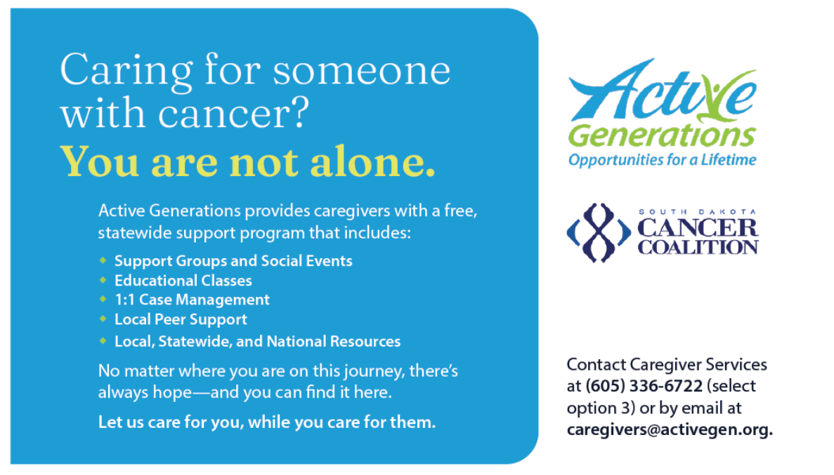
Notes:
We are partnering with Active Generation to provide us with assistance in the support network. While online resources are widely available, we believe there is a crucial need for in-person support—a space where caregivers can gather, connect, and build community. This program fills that gap, offering meaningful opportunities for caregivers to feel seen, heard, and supported.
Our program offers:
Support groups & social events
Educational classes
One-on-one case management
Peer-to-peer support connections
You will be receiving an email from me and our coalition newsletter soon with ways you can help support the cancer caregiver network. If you or anyone you know it interested feel free to take a card or reach out to Meghan who will be facilitating the program.

